Slide 1
Lesson: 1
What is Machine Learning?
(Layman’s term)

Slide 2

Human can learn from past experience and make decision of its own
2

Slide 3
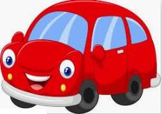
What is this object?
3

Slide 4
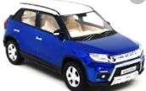

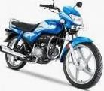
What is this object?
CAR
CAR
BIKE
It is a CAR
BIKE
4

Slide 5

Let us ask the same question to him
What is this object?
5

Slide 6


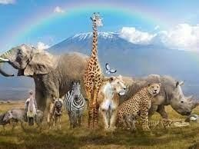
Let us ask the same question to him
?
What is this object?
6

Slide 7
[ But, he is a human being. He can observe and learn ]

Slide 8

Let us make him learn
show him
8

Slide 9
Let us make him learn
CAR
show him
CAR
BIKE
BIKE
9

Slide 10
Let us ask the same question now
What is this object?
CAR
CAR
BIKE BIKE
Past experience
10

Slide 11

Let us ask the same question now
CAR
What is this object?
CAR
CAR
BIKE BIKE

Slide 12

What about a Machine ?
Machines follow instructions
[ It can not take decision of its own]

Slide 13
What about a Machine ?
We can ask a machine
To perform an arithmetic operations such as
Addition
Multiplication
Division
Machines follow instructions

Slide 14
What about a Machine ?
Comparison
Print
Plotting a chart
Machines follow instructions

Slide 15
What is Machine Learning?
[ We want a machine to act like a human]

Slide 16

What is Machine Learning?
[ to identify this object.]

Slide 17
What is Machine Learning?
Price in 2025?
[ predict the price in future]

Slide 18
What is Machine Learning?
I made met him yesterday
[ Natural Language understand, and correct grammar ]

Slide 19

What is Machine Learning?
recognize face
[ Recognize Faces ]

Slide 20
What is Machine Learning?
[ What do we do?
Just like, what we did to human, we need to provide experience
to the machine.
]

Slide 21
What is Machine Learning?
[
This what we called as Data or Training dataset
+
So, we first need to provide training dataset to the machine
]
Dataset

Slide 22

What is Machine Learning?
+
+
[ Then, devise algorithms and execute programs on the data
With respect to the underlying target tasks ]
Dataset

Slide 23

What is Machine Learning?
+
+
+
Dataset
[ Then, using the programs, Identify
required rules ]

Slide 24

What is Machine Learning?
+
+
+
Dataset
[extract required patterns ]

Slide 25

What is Machine Learning?
+
+
+
Dataset
[ Identify relations ]

Slide 26
+
What is Machine Learning?
=
+
+
Dataset
[ So that machine can derive inferences
from the data ]

Slide 27


In summary, what is machine learning?
Given a machine learning problem
Identify and create the appropriate dataset
Perform computation to learn
Required rules, pattern and relations
Output the decision

Slide 28
Machine Learning Paradigms
Supervised
Unsupervised Learning
Reinforcement learning
[ We as human being solve various types of problem in our day-to-day life, <pause> Various decisions need to be taken.
Depending on the nature of the problem, machine learning tasks can be broadly divided in ]

Slide 29
What is Supervised Learning?
CAR
+
CAR
₌ Training Dataset
BIKE
BIKE
Samples
Labels
[In supervised learning, we need some thing called a Labelled Training Dataset ]

Slide 30
What is Supervised Learning?
CAR
+
CAR
₌ Training Dataset
𝑓( , )=
BIKE
BIKE
Samples
Labels
[ Given a labelled dataset, the task is to devise a function which takes the dataset, and a new sample, and
produces an output value.]
30

Slide 31

What is Supervised Learning?
CAR
+
CAR
₌ Training Dataset
𝑓( , )=
BIKE
BIKE
Samples
Labels
[ Given a labelled dataset, the task is to devise a function which takes the dataset, and a new sample, and
produces an output value.]
31

Slide 32
What is Supervised Learning?
CAR
+
CAR
₌ Training Dataset
𝑓( , )= CAR
BIKE
BIKE
Samples
Labels
[ Given a labelled dataset, the task is to devise a function which takes the dataset, and a new sample, and
produces an output value.]
32

Slide 33
What is Supervised Learning?
CAR
Classification
𝑓( , )= CAR
+
CAR
₌ Training Dataset
BIKE
BIKE
Samples
Labels
[ If the possible output values of the function are predefined and discrete/categorical, it is called
Classification
33

Slide 34
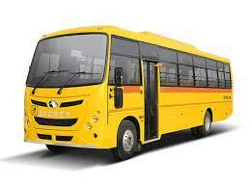
What is Supervised Learning?
CAR
Classification
𝑓( , )= CAR
+
CAR
₌ Training Dataset
BIKE
BIKE
Samples
Labels
[ Predefined classes means, it will produce output only from the labels defined in the dataset. For example,
even if we input a bus, it will produce either CAR or BIKE ]

Slide 35
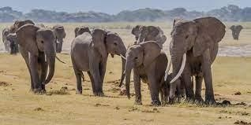
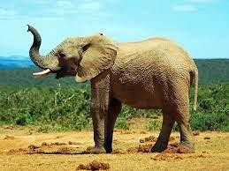
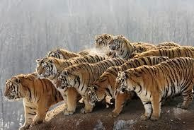
Classifier
Elephant
Tiger
Elephant
Classifier
Identify the Animal ?
Dataset

Slide 36
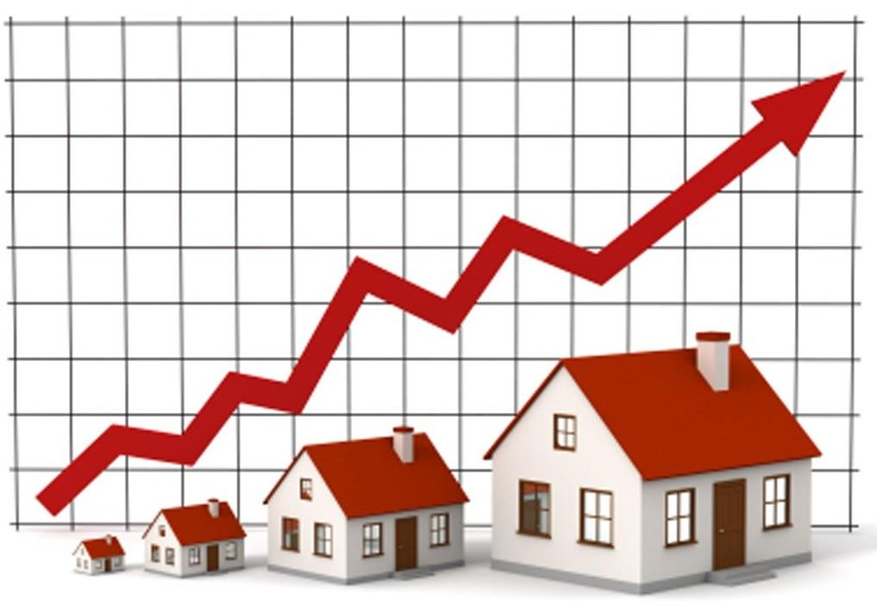
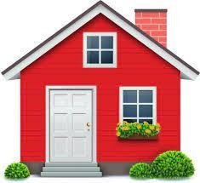
Regression
Regression
𝑓( , )= 20500.50
Dataset
[ If the possible output values of the function are continuous real values, then it is called Regression

Slide 37
[
The classification and Regression problems are supervised, because the decision depends on the characteristics of the ground truth labels or values present in the dataset, which we define as experience
]

Slide 38
What is Unsupervised Learning
CAR
CAR
BIKE BIKE
Dataset
[ In the unsupervised learning, we do not need to know the labels or Ground truth values ]

Slide 39
What is Unsupervised Learning
Clustering
Dataset
[ The task is to identify the patterns like group the similar objects together ]
39

Slide 40

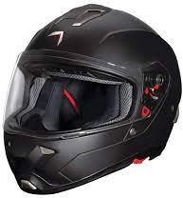
What is Unsupervised Learning
Association Rules Mining
Dataset
[ Association rules like ]

Slide 41
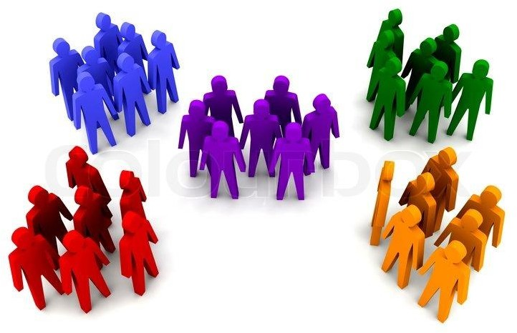
More Example Unsupervised Learning
Dataset

Slide 42
More Example Unsupervised Learning
Dataset

Slide 43


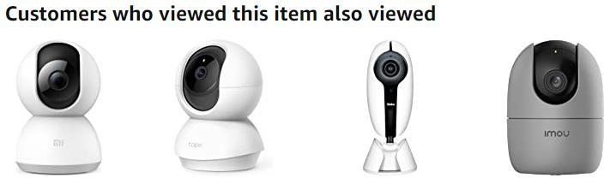
More Example Unsupervised Learning

Slide 44
What is Reinforcement Learning
[ It is also known as learning from trials and errors ]

Slide 45


What is Reinforcement Learning

Slide 46

What is Reinforcement Learning

Slide 47


What is Reinforcement Learning

Slide 48

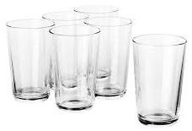




Another Example
Agent
Task
Environment

Slide 49

Reinforcement Learning
Punishment

Slide 50

Reinforcement Learning
Reward

Slide 51
Reinforcement Learning
Reward
Baby Learn from the Trials and Errors
Reinforcement Learning

Slide 52
Summary
what is machine learning
what are the machine learning paradigms
[ In this lesion, we have learnt ]

